Slide 1

360DigiTMG
Clinical Process Phases
FSDS Capstone Project

Slide 2
1. Too Many Patients, Not Enough Hospitals – The current healthcare infrastructure in most countries simply isn’t equipped to deal with large volumes of patients.
Why Hospital Queues Are So Long?
2. Triaging the Queue – What is triaging, exactly? Basically, it’s the process of deciding the order of patients to serve. The thing is, not all patients are in equal need of care. Some patients are coming in for a follow-up visit. Others queue up for a general check-up or, as it often happens, “just to ask a quick question”.
How did it happen that, as patients, we pretty much expect to have a terrible experience when visiting hospitals?
A better question is, “Why is hospital wait time so long?” Long queues may seem like a characteristic of hospitals at this point, but there must be an explanation as to how this came to be.
3. Emergency Situations – By their very nature, emergency cases need to be attended to over anything else. A separate emergency room makes sure that hospitals are not affected by emergencies and continue to function normally. Emergencies do happen, and nowhere is it as apparent as in healthcare.
4. Visiting a Hospital at the Worst Time – The topic of the worst times to visit a hospital is as interesting as it is practical. We’ve already covered it in some detail, but in case you missed it, here’s a recap of the worst times:
The sick month on a specific country.
Public holidays like Christmas.
Weekends.
Night times.
5. Inefficient Queuing at Hospitals:
For one, appointments can be very problematic — instead of letting you prepare for the day’s activities, they break down the daily schedule.
A few cases of late arrivals, no-shows, or a longer-than-average visit completely derail the entire day at the hospital.
Then there’s the use of obsolete technologies like sign-in sheets. Paper sign-in sheets are inefficient in terms of not only time, but also the unnecessary strain they put on your administrative staff. And to top it off, there is the security threat they pose. -Learning to manage walk-ins the right way using a queue management system is a much better alternative.

Slide 3
1. Work as Systems and Processes – An organization needs to understand its own delivery system and key processes, rather than considering it as small and simple or big and complex. The key to the quality improvement approach in any size of an organization should be, to streamline “Input – Process – Output” to meet the needs of a specific organization’s health service delivery system.
Process improvement in healthcare means a systematic approach by a healthcare organization that monitors, assesses and improves the standards of quality healthcare. The organizational chain of activities is cyclic and needs continues improvement to seek a higher level of performance. Continuous upgradation in healthcare activities can pull out healthcare organizations from inefficient traditional concepts and utilize technology/tools to perform efficiently and hence generate better quality results.
2. Focus on Patient – The major concept behind the quality improvement in healthcare is to get the patient’s needs and expectations on the same page. Services that are designed to bring needs and expectations together include:
Patient Safety
Patient Engagement
Systems that support patient access
Evidence-based care provision
Patient-centered communication
Health literacy of patients
3. Focus on the use of data – Data is the cornerstone of quality improvement. It describes how current systems are working, tracks the changes, allows comparison and monitoring for sustainable improvements. Data-driven insights deliver better outcomes, minimum variation, fewer re-admissions, lower infection rates, and fewer medical errors. Both qualitative and quantitative methods of data collection are used to improve the quality of the healthcare system.
“Improvement in Healthcare is Important”
4. Focus on Care-coordination – It is the coordination of care activities. Care coordination software maintains the Master Patient Index and Longitudinal Health Record for each patient (It becomes very effective if it is a case of a chronic condition). It helps reduce care fragmentation of a patient, by providing a secure network of trusted healthcare providers and ensure effective referrals and smooth transitions between two or more healthcare providers.

Slide 4
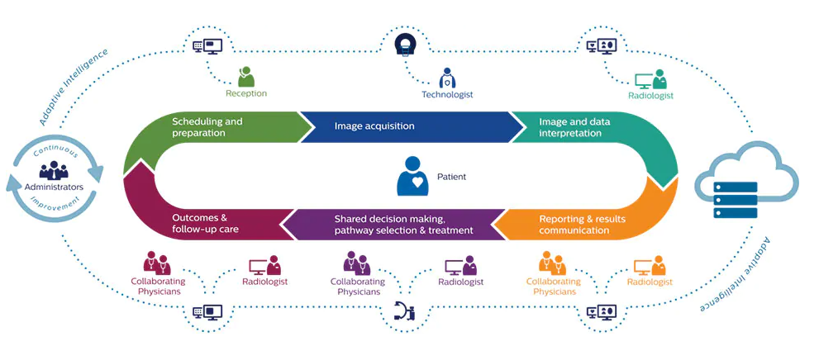
Clinical Trial Process

Slide 5
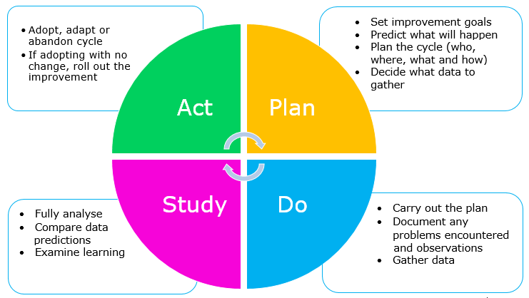
Clinical Process Improvement
How will we know if a change is an improvement
What are we going to improve?
What change can we make that will lead to improvement
What are the things that we need to improve in the hospital? And how much can we improve it.
We need to know if the improvement we choose is measurable, doable, and reliable.
“If we can’t measure it we can’t improve it” – Lord Kelvin

Slide 6
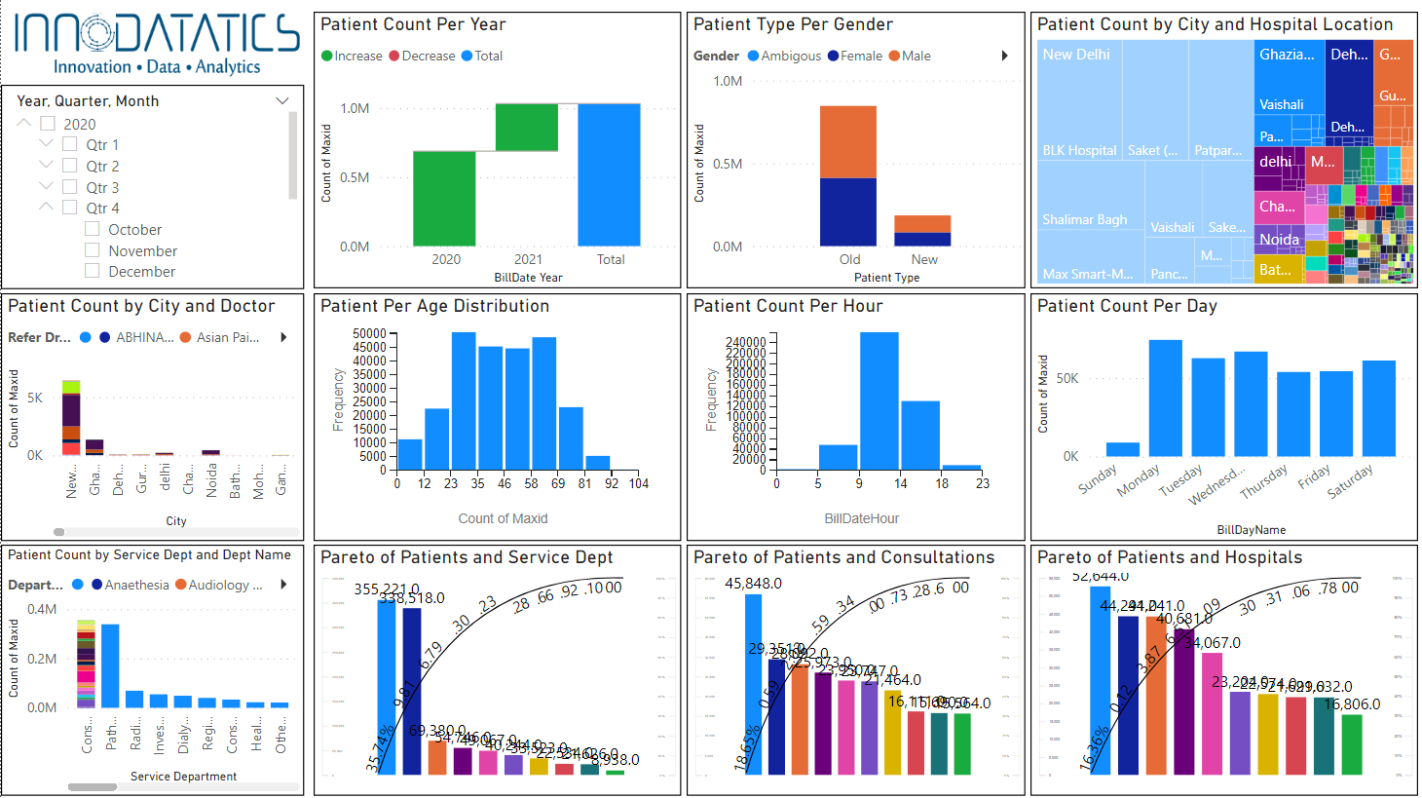
Exploratory Data Analysis

Slide 7
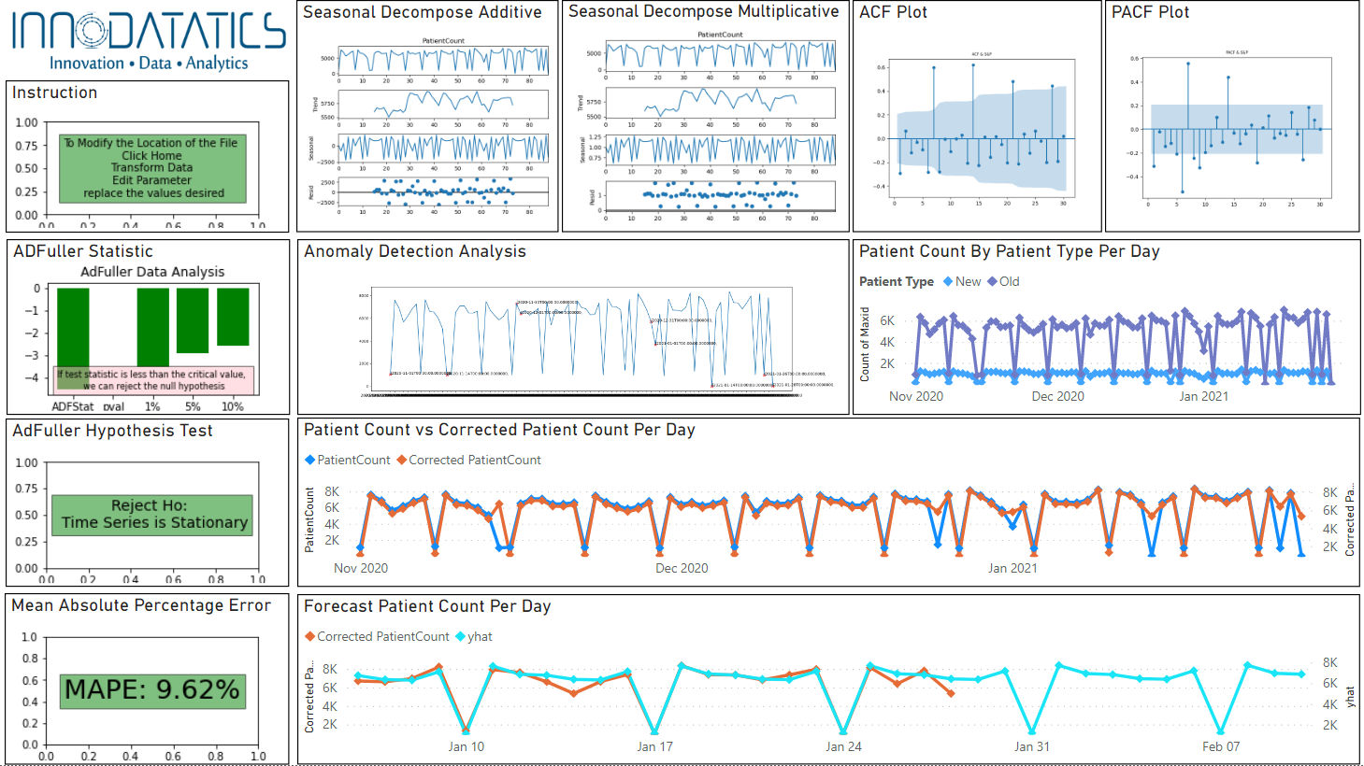
Forecasted Analytics

